Slide 1



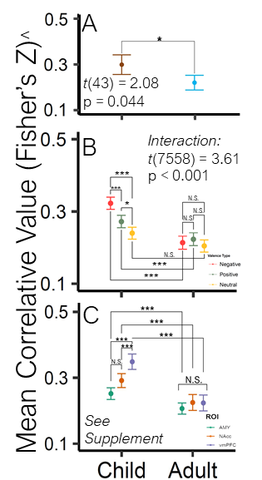
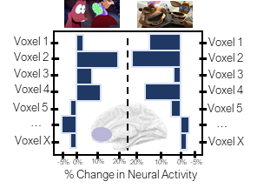
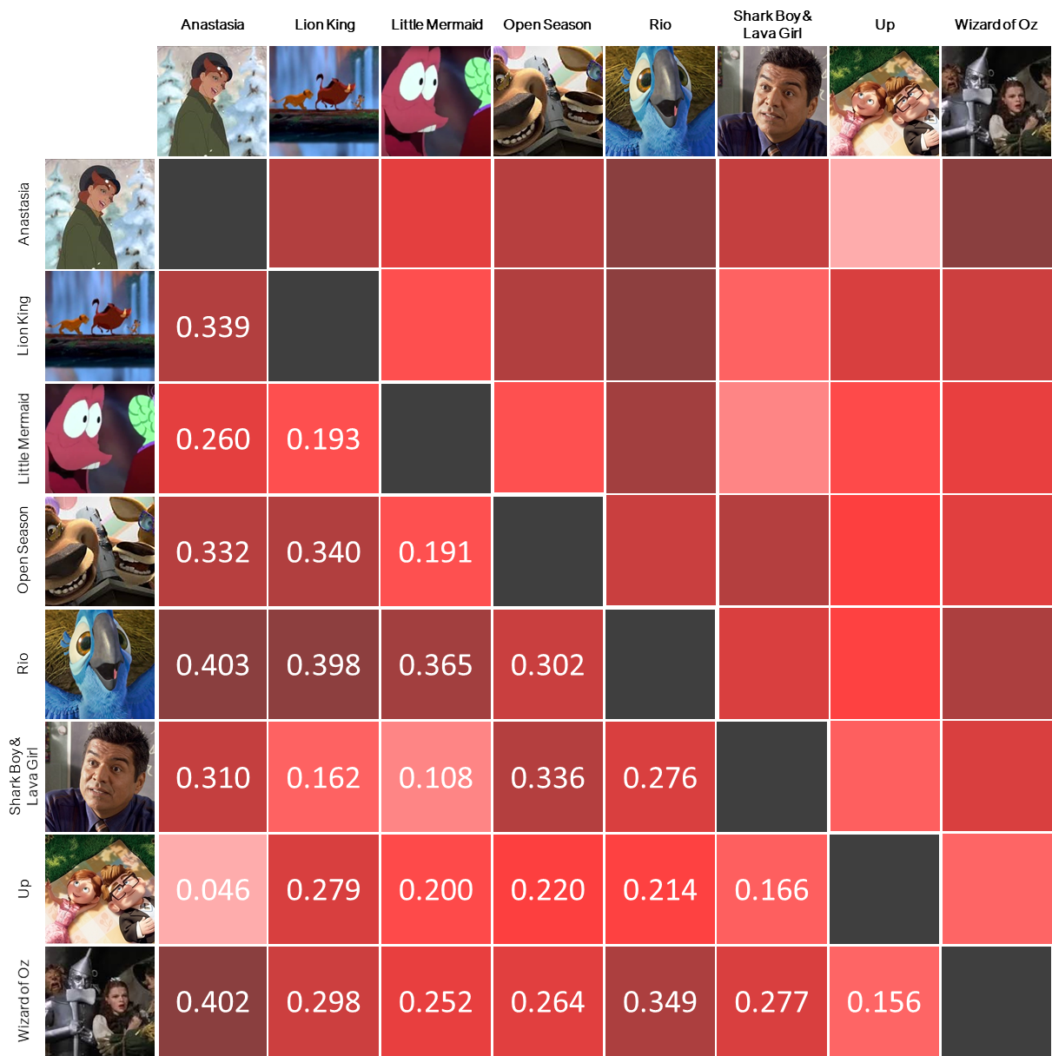
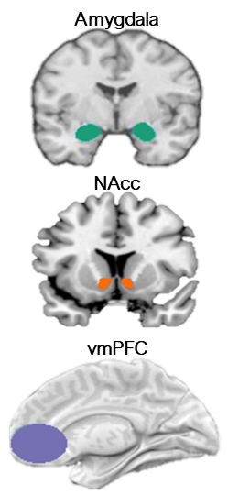

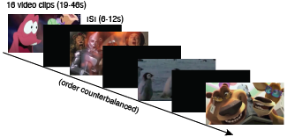


William Mitchell*, Lindsey Tepfer, Nicole Henninger, Vishnu Murty,
Chelsea Helion, Susan Perlman
Do You Feel How I Feel? Developmental Differences in Affective Representation
*Contact: Billy.Mitchell@temple.edu
Background
Hypotheses
Analyses
It is unclear how affective neural representations may differ between children and adults in select regions which are implicated in behavioral responses¹⁻².
Differences in neural activation patterns may reflect differences in cognitive representations, which may motivate the observed developmental differences in behavioral phenomena.
Children will demonstrate greater representational similarity than adults.
Children will generate greater discrepancies in valenced representational similarity than adults.
Children and adult subcortical ROI representations will be more similar than representations in the vmPFC.
Intravalence pattern similarity was calculated using RSA. Spearman’s rank methods and Fisher’s Z transformation were used to calculate correlations.
Differences in pattern similarity were assessed using a 3 (ROI) x 3 (Valence) x 2 (Age Group) Mixed Effects ANOVA with Bonferroni-adjusted post-hoc contrasts.
Sample
ROIs
RSA Calculation Example
Calculating RSA: Correlations were performed within individual and ROI, between stimuli of the same valence type (1). Matrices house the mean correlative values across participants of the same age group for stimuli pairs in any one ROI (2), which required the construction of 12 separate matrices. The average correlative value of a matrix symbolizes representational similarity of a valence type for one ROI and age group. Higher values suggest greater similarity. Mean values and variances can be analyzed in traditional ANOVA to measure representational pattern differences.
1
2
Methods
We explored differences in neural activation pattern similarity measured using fMRI between children and adults across the amygdala, NAcc, and vmPFC, while passively viewing 24 affectively valenced film clips (8 Pos, 8 Neg, 8 Neut), which were counter-balanced for affect, time, social stimuli, and luminosity ³.
r value
Pattern Similarity ⁴
Discussion
Task Design
What is it?: When different stimuli generate overlap in neural activity patterns, we assume this is in response to a characteristic which those stimuli have in common that that ROI is processing. Why does it matter?: We can better infer how representations are structured which may have downstream effects on cognition and behavior.
Our results suggest that affective representations decrease in pattern similarity over development.
The differences between subcortical and prefrontal structures in adults and children may suggest a maturation from visceral affective responses which merely assess how evocative an affective experience is, to more evaluative analyses which modulate affective responses.
More research is needed before these analyses can directly be linked to behavioral differences.
Task Design
^ Note: Full range (-1.77 to 1.76) of Y-Axis restricted in visuals for comprehension sake. Error bars represent 95% confidence intervals.
Abbreviations
Results
References
fMRI – Functional Magnetic Resonance Imaging
NAcc – Nucleus Accumbens
ROI – Region of Interest
RSA – Representational Similarity Analysis
vmPFC – Ventromedial Prefrontal Cortex
Children demonstrated greater representational similarity than adults.
Children demonstrated valence-specific differences, but adults did not.
Children showed differences between subcortical ROIs and vmPFC, but adults failed to demonstrate differences.
Nook, E. C., Sasse, S. F… & Somerville, L. H. (2017). Increasing verbal knowledge mediates development of multidimensional emotion representations. Nat. Human Behav., 1(12), 881–889.
Silvers, J. A., McRae, K., … & Ochsner, K. N. (2012). Age-related differences in emotional reactivity, regulation, and rejection sensitivity in adolescence. Emotion, 12(6), 1235–1247.
Karim, H. T., & Perlman, S. B. (2017). Neurodevelopmental maturation as a function of irritable temperament. Human Brain Map., 38(10), 5307–5321.
Popal, H. S., Wang, Y., & Olson, I. R. (2019). A Guide To Representational Similarity Analysis for Social Neuroscience. Social Cog. Affect. Neurosci., 14(11),1243–1253.
Notes:
Behavioral and cognitive studies suggest that children develop more complex conceptions of emotion and expressions of affectivity across normative development and into adulthood.
Between these periods there are a lot of changes in the connectivity and structure of regions
which might exhibit neuromodulatory effects relevant to affective experiences.
It may be the case that as these structures develop, how individuals represent affective information,
or the ways in which they mentally render charactistics of the concept, become more complex as well.
And this is relevant because representations may have an influence on downstream processes that affect future cognition and behavior.
To determine whether these differences in affective representations exist,
We’d asked 36 children and 21 adults to passively watch a custom stimuli set while undergoing an fMRI scan.
1 Adult and 11 children were excluded from the final dataset for excessive head motion
The stimuli set contained 8 positive and 8 negative clips from 8 popular children’s movies, such that each movie provided both a positive and negative clip.
8 Neutral clips were also sourced from various nature documentaries.
The order of clips were pseudo-randomized to one of three possible conditions.
All clips were normalized by luminosity.
Clips contained both animated and live action movies,
anthropomorphic and human characters
and spanned a long time period, with release dates from 1939 to 2011.
In terms of quality control: No group differences in familiarity were observed between adults and children.
Independent raters counter balanced clips on a second-by-second basis for affective intensity,
affective presence,
and presence of social stimuli.
We identified three regions relevant to our question:
the Amygdala,
the nucleus accumbens within the ventral striatum,
and the ventromedial prefrontal cortex.
And we chose these sites because The literature suggests all three should represent affective information
and may undergo structural and functional changes over normative development.
Additional details about our stimuli and pre-processing
are captured in the supplementary handout I’d included.
From each of our three regions, we’d captured patterns of changes in neural activation over subsequent stimuli presentations.
By correlating neural activation patterns across stimuli of the same valence and within the same ROI,
we can use a method called representational similarity analysis
to arrive at a value that symbolizes the strength of the representation of that valence for a particular region.
In other words, when a region produces a highly similar pattern
in response to different stimuli all holding one characteristic in common,
it can be inferred that the observed response is a product of that common characteristic.
Once we arrive at those values, which are essentially non-parametric correlations,
one could spatially analyze the correlation matrix they’d produced,
or refer to a more traditional analysis of variance.
So with that in mind, we hypothesized that adults would generate less pattern similarity than children,
and this is based on the theory that they’ll entertain more complex conceptions of emotion.
We also hypothesized that children would generate a greater difference between positive and negative pattern similarity than adults.
Lastly, because of the profound developmental changes associated with the vmPFC relative to subcortical structures,
we hypothesized the interaction between subcortical structures and the vmPFC
would produce greater variance in representational pattern similarity for children relative to adults.
After computing our RSA values using a Spearman Rank Correlation and applying a Fisher’s Z transformation,
our values were entered into a 3 x 3 x 2 Mixed Effects ANOVA,
with terms for ROI, Valence, Age Group, and interactions among them.
Additional contrasts were pursued post-hoc and Bonferroni-adjusted.
Prior to pursuing our primary analysis, we explored the coherence of our child grouping.
We did this by entering age as a predictor towards pattern similarity in a mixed effects linear regression model
We found no relationship among children by age,
suggesting no reason for us to treat the values we observe from a child at age 4 and differently than we would a child at age 10.
In all cases for our primary analyses, we supported our hypotheses.
Children did demonstrate greater pattern similarity relative to adults.
Children also demonstrated greater negative pattern similarity relative to positive pattern similarity; an effect which was not mirrored in their older counterparts.
Children also demonstrated greater affective pattern similarity relative to our neutral control, while adults did not seem to differentiate along affective lines.
Lastly, adults demonstrated no ROI differences while children demonstrated differences between the vmPFC and each subcortical structure.
All in all, these results do suggest that differences in affective representation exist between adults and children.
Being put in the context of the extant research, this may reflect a maturation from visceral affective responses to more evaluative processes.
However, given these analyses, we cannot speak with any certainty as to exactly what about these representations are similar,
what mechanisms might contribute to a change in representation,
and whether these representations do have any meaningful impact on behavior.
Futures analyses should explore these relationships.

Slide 2
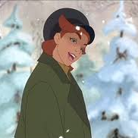
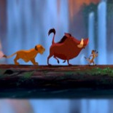
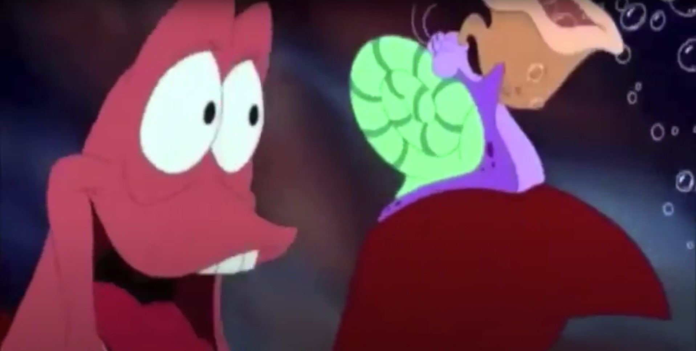



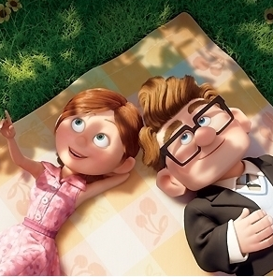
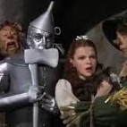

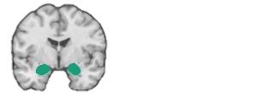
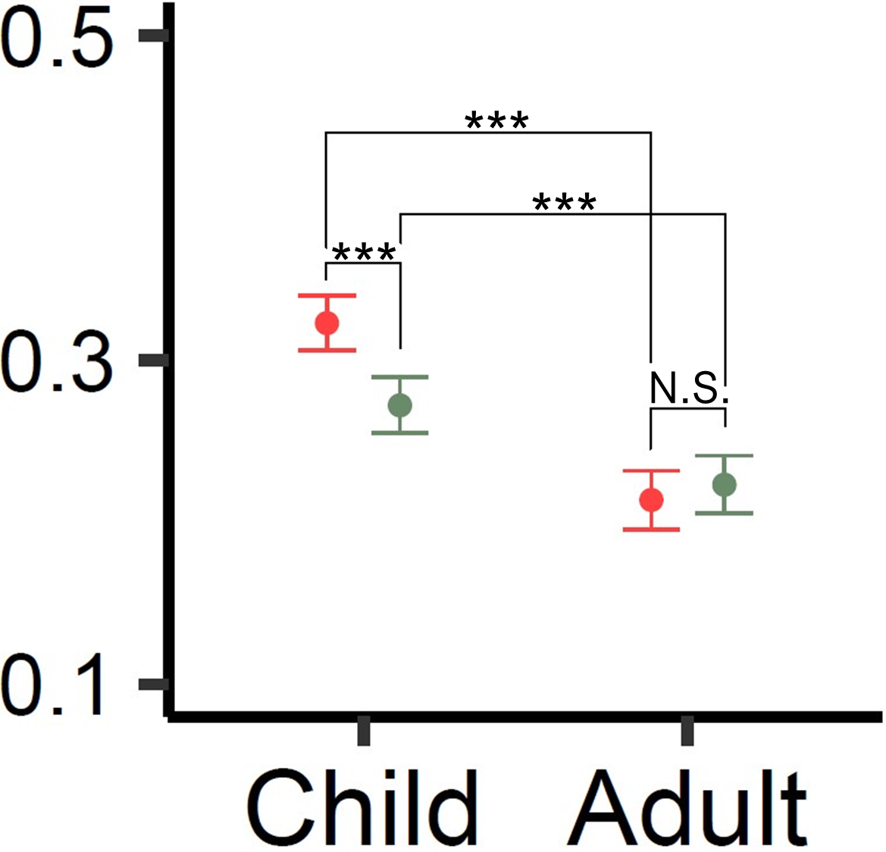
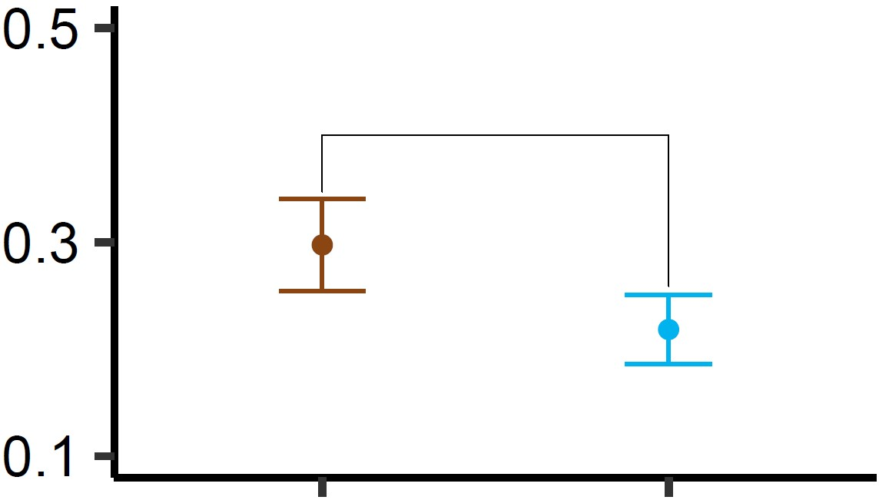
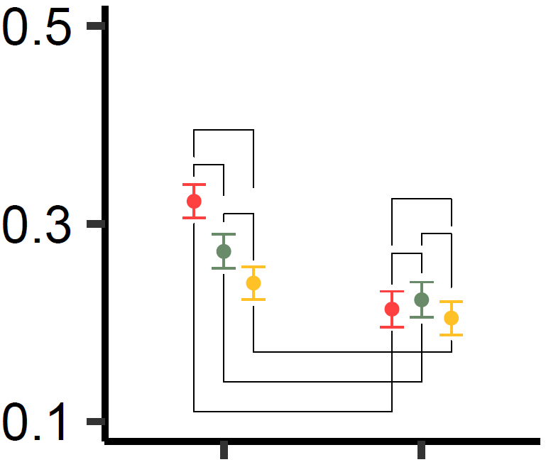
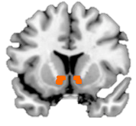
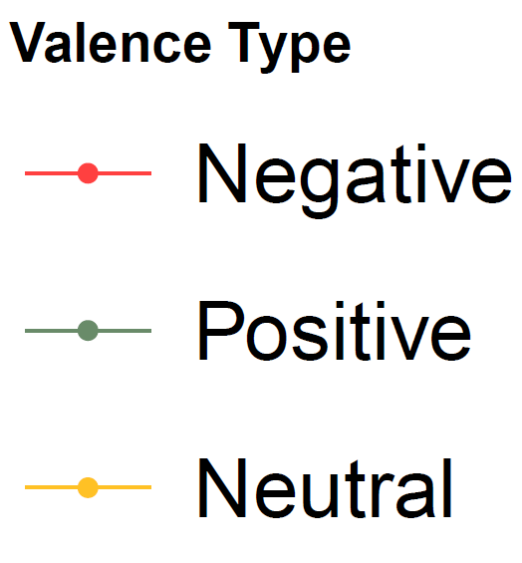

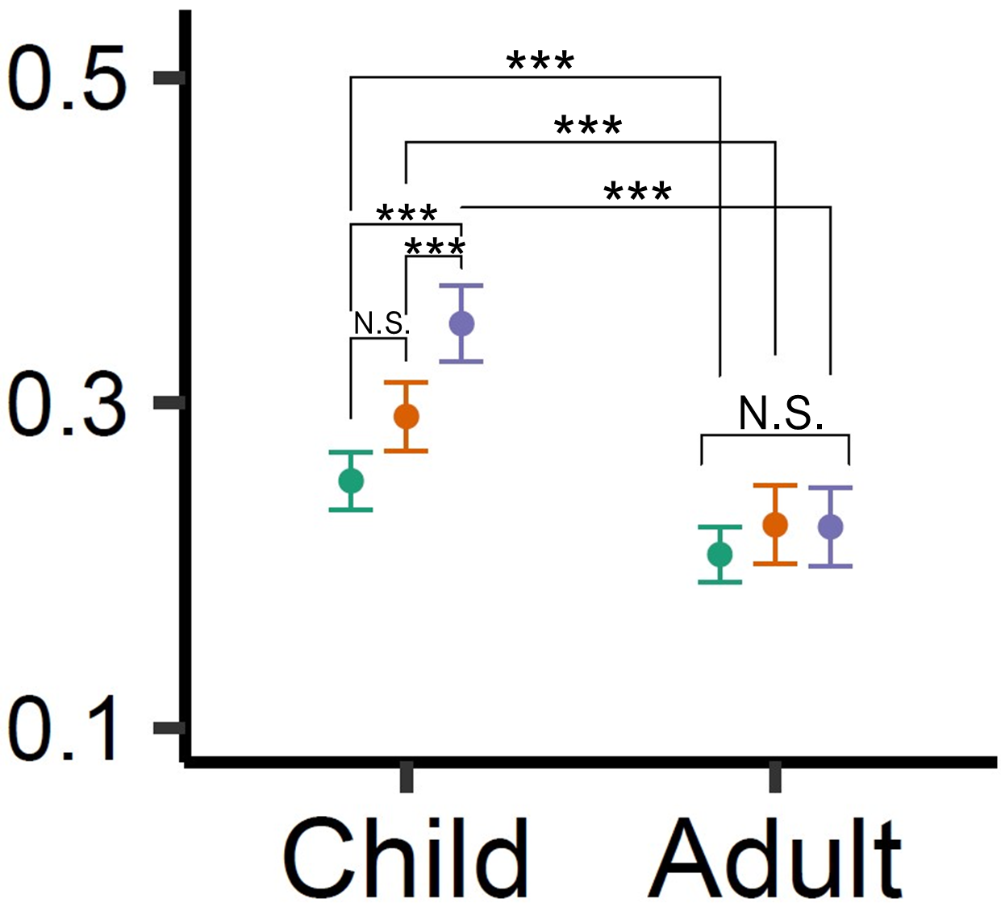
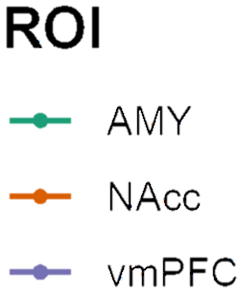
Anastasia
Lion King
Little Mermaid
Open Season
Rio
Shark Boy &
Lava Girl
Up
Wizard of Oz
Anastasia
Amygdala
0.339
A
Lion King
*
t(43) = 2.08 p = 0.044
0.260
0.193
NAcc
Little Mermaid
B
Interaction: t(7558) = 3.61
p < 0.001
***
***
N.S.
*
N.S.
0.332
0.340
0.191
N.S.
Mean Correlative Value (Fisher’s Z)^
Voxel 1
Voxel 1
Open Season
N.S.
Voxel 2
Voxel 2
***
vmPFC
Voxel 3
Voxel 3
***
Voxel 4
Voxel 4
C
Voxel 5
Voxel 5
…
…
0.403
0.398
0.365
0.302
Voxel X
Voxel X
10%
20%
0%
20%
10%
-5%
-5%
0%
Rio
% Change in Neural Activity
See Supplement
0.310
0.162
0.108
0.336
0.276
Shark Boy &
Lava Girl
0.046
0.279
0.200
0.220
0.214
0.166
Up
0.402
0.298
0.252
0.264
0.349
0.277
0.156
Wizard of Oz

Slide 3
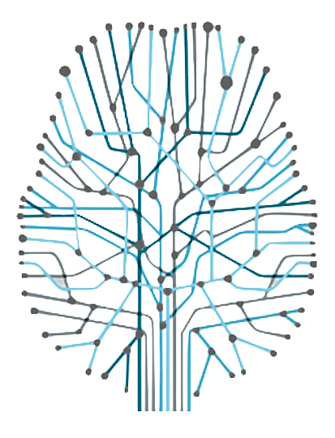


2 0 2 1
SAN LAB
24

